Slide 1

NEUROSYNC
Predictive intelligence for the equipment that can’t afford to fail.
EDGE AI • ON-DEVICE INFERENCE • ZERO CLOUD DEPENDENCY

Slide 2

WE’VE SEEN THIS BEFORE
Every major industrial disaster of the last 50 years shared one thing in common.
The failure was measurable — pressure, vibration, gas, heat — long before it became visible. Nobody was watching closely enough, in real time, to act.
DEEPWATER HORIZON · APRIL 20, 2010
11
134M
$65B+
Rig workers killed
Gallons of oil spilled
Total cost to BP
An undetected mechanical failure on the blowout preventer — a condition sensors could have flagged — triggered the worst offshore oil spill in U.S. history.
THE COST OF NOT KNOWING
02 / 08

Slide 3




THE PROBLEM
Oil & gas still runs on hindsight, not foresight.
Three out of four operators still use reactive or time-based maintenance — fixing equipment after it breaks, or on a fixed calendar that ignores actual condition.
27 days
$149M
~$500K
$2.5T
of unplanned downtime per year on the average offshore platform
average annual downtime loss per site — up 76% since 2021
lost for every single hour of unplanned downtime today
estimated global cost of corrosion-driven failures each year
Sources: Kimberlite Research; Innovapptive; Birlasoft; MaxGrip industry analysis, 2024–2026
REACTIVE MAINTENANCE
03 / 08

Slide 4







THE SOLUTION
NeuroSync watches, thinks, and acts — on the equipment itself.
Edge AI Model
Vibration
Gas
Temperature
Corrosion
Risk Alert
Manual-Control Chatbot
Runs 100% on-device — no cloud, no connectivity required
MPU6050
MQ2
DS18B20
Moisture probe
Ranked, explainable score
Operator asks, confirms, overrides
Self-learning loop — every confirmed outcome retrains the on-device model
Built on Arduino UNO Q — sensors, edge inference, and alerting run on under $80 of hardware per node.
HOW IT WORKS
04 / 08

Slide 5

THE PIPELINE
Three tiers. One autonomous decision chain.
From a raw sensor voltage to a written emergency protocol — zero cloud dependency at every step.
LEVEL 1 — EXTREME EDGE
LEVEL 2 — HEAVY EDGE
LEVEL 3 — GENERATIVE COPILOT
On-Sensor Decision Tree
Adaptive ML Classifier
Local LLM Response
MCU Node · STM32 / Arduino
MPU Node · Qualcomm Snapdragon
AI PC · Snapdragon X Elite
TinyML · C++ Decision Trees
ONNX Runtime · Random Forest
Google Gemma 2B/7B · Ollama
Processes raw MPU6050, MQ2, and DS18B20 signals directly on the microcontroller — zero delay, zero dependency.
MCU serial data feeds a Python backend on-device, running a Random Forest model compiled to ONNX on the Snapdragon Hexagon DSP.
When Level 2 confirms an anomaly, this tier activates — no internet connection needed at any point.
THE MAGIC
THE MAGIC
THE MAGIC
Subtracts gravity from the raw signal to isolate pure vibration, producing an instant Risk Index — light enough to run on the smallest microcontrollers.
Learns each machine’s own resting noise (±2.0) and tunes its own safe threshold (e.g. 2.5). A +15.0 spike past that limit is classified instantly — bearing wear vs. gas leak.
A 5GB Gemma model runs fully on-device, reading live vibration, temp, and gas telemetry as its prompt to write a 3-step autonomous Emergency Maintenance Protocol in seconds.
THE PIPELINE, UNDER THE HOOD
05 / 08

Slide 6
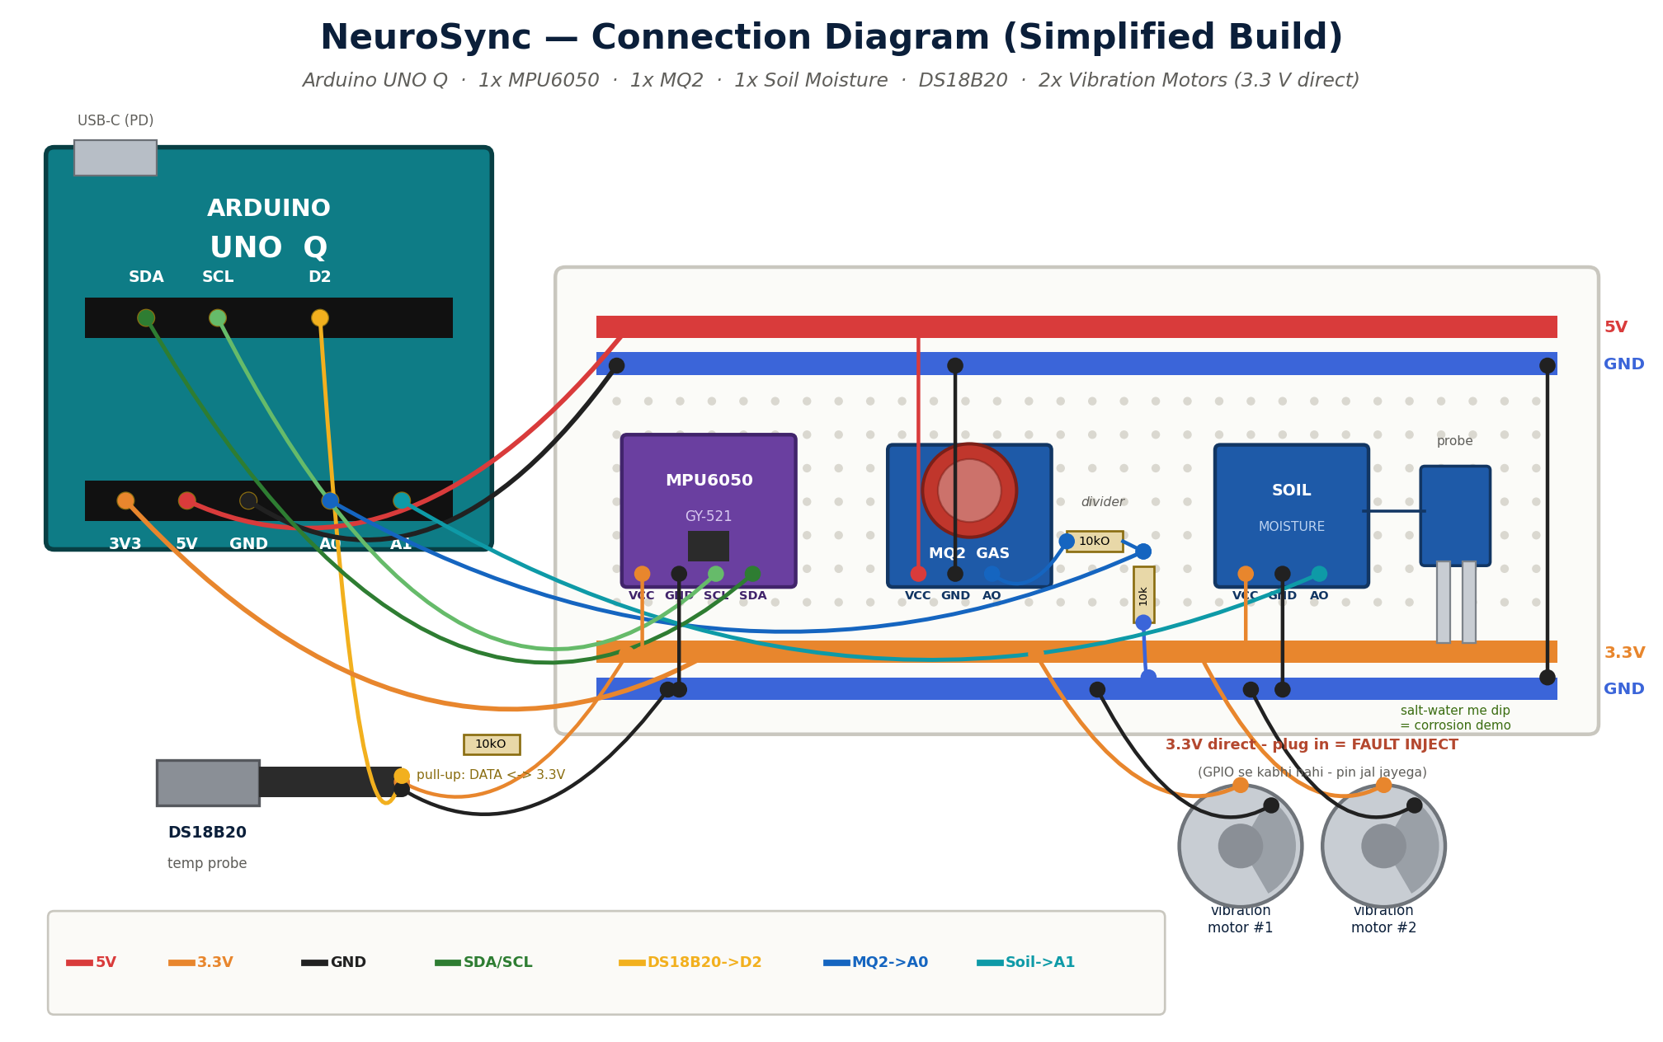
THE BUILD
Field-tested hardware. A control room in your pocket.
MOBILE APP
Fleet-wide risk ranking, live, per asset
One-tap connect to the Arduino UNO Q over local Wi-Fi
Offline-ready — plant data never leaves the site
HARDWARE, PER NODE
Compute
Arduino UNO Q (on-device NPU)
Sensing
Vibration · gas · temperature · moisture
Cost
Under $80 in components
Connectivity
Local Wi-Fi — no cloud dependency
HARDWARE + APP
06 / 08

Slide 7



THE OPPORTUNITY
A market moving fast toward what NeuroSync already does.
94–97%
failure-prediction accuracy achievable with modern edge-AI condition monitoring, at up to 72 hours’ warning
$15.7B → $96.6B
Global predictive maintenance market, 2026 to 2035 — a 22.4% CAGR.
Up to 36%
reduction in unplanned downtime from data-driven predictive maintenance programs
Driven by the same $864B annual cost of unplanned industrial downtime NeuroSync is built to cut.
15–40%
typical maintenance-cost savings moving from reactive to predictive strategies
Sources: Evolvance Market Research; Grand View Research; MarketsandMarkets; U.S. DOE, 2025–2026
MARKET + IMPACT
07 / 08

Slide 8
The next disaster is measurable today.
NeuroSync puts real-time sensing, on-device AI, and a self-learning safety net on every asset that can’t afford to fail — before it becomes tomorrow’s headline.
We’re raising to take NeuroSync from field-tested prototype to fleet-wide deployment.
LET’S TALK · hello@neurosync.tech
08 / 08

